Slide 1
Senior Nation Ames Health Program 2015 Building Cultures of Hope: Growing a Growth Mindset (Lesson Two) http://amesmindset.weebly.com

Slide 2
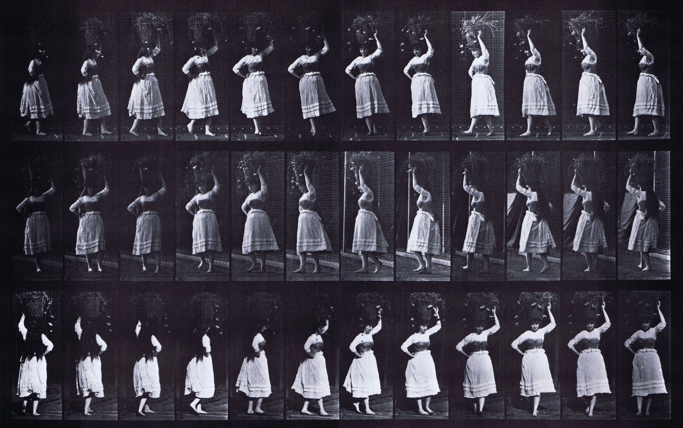
TODAY WE ARE GOING TO LEARN TO TURN
To learn to turn, we are going to
be divided into two schools

Slide 3
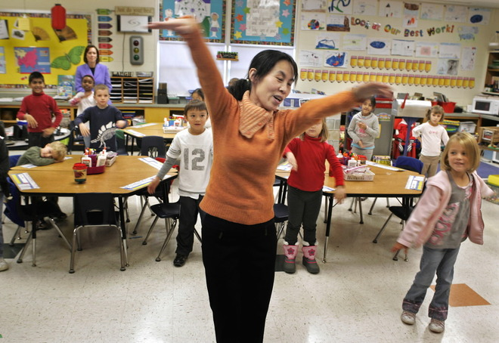
THE I AND THE E SCHOOL OF TURNING

Slide 4
Noel the First
In order to discover the secret of growth mindset, we are going to listen to a story about a girl who appears to be a natural ballet star!

