Slide 1
Senior Nation Ames Health Program 2015 Building Cultures of Hope: Growing a Growth Mindset http://amesmindset.weebly.com

Slide 2
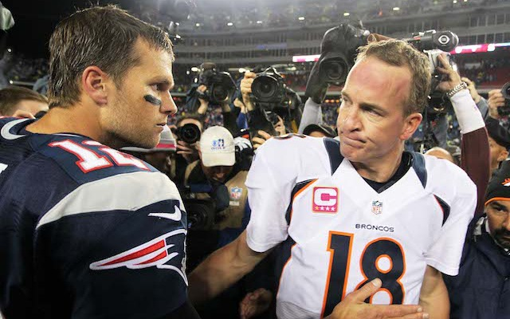
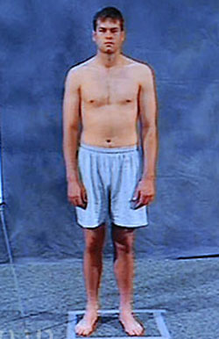
Eliminate an NFL Quarterback from the Combine Scores
Congratulations, you just eliminated Tom Brady
Player 40-Dash 20-Dash 10-Dash Vertical Broad Shuttle 3-Cone
1 4.67 X X 36 10'04" 4.28 6.80
2 4.41 X X 39 10’ X X
3 5.28 2.94 1.70 24 08'03" 4.38 7.20
4 4.83 2.75 1.66 32 08'09" 4.21 7.09
5 4.71 2.75 1.65 34 09'02” X 7.39
7 4.66 2.63 1.62 34 9'6" 4.29 6.99
8 5.08 2.85 1.69 31 X 4.34 X
Player 40-Dash 20-Dash 10-Dash Vertical Broad Shuttle 3-Cone
1 4.67 36 10'04" 4.28 6.80
2 4.41 X X 39 10’ X X
3 5.28 2.94 1.70 24 08'03" 4.38 7.20
4 4.83 2.75 1.66 32 08'09" 4.21 7.09
5 4.71 2.75 1.65 34 09'02” X 7.39
7 4.66 2.63 1.62 34 9'6" 4.29 6.99
8 5.08 2.85 1.73 31 4.34 X
NFL Agreed with your
Choice—last quarterback
Drafted #7 in seventh round
199th Player Drafted
Notes:
The defense is on the 9th right?

Slide 3
SELF-BELIEF AND EFFORT Trumps Ability
Tom Brady Failed Well.
Do you fail well?

Slide 4
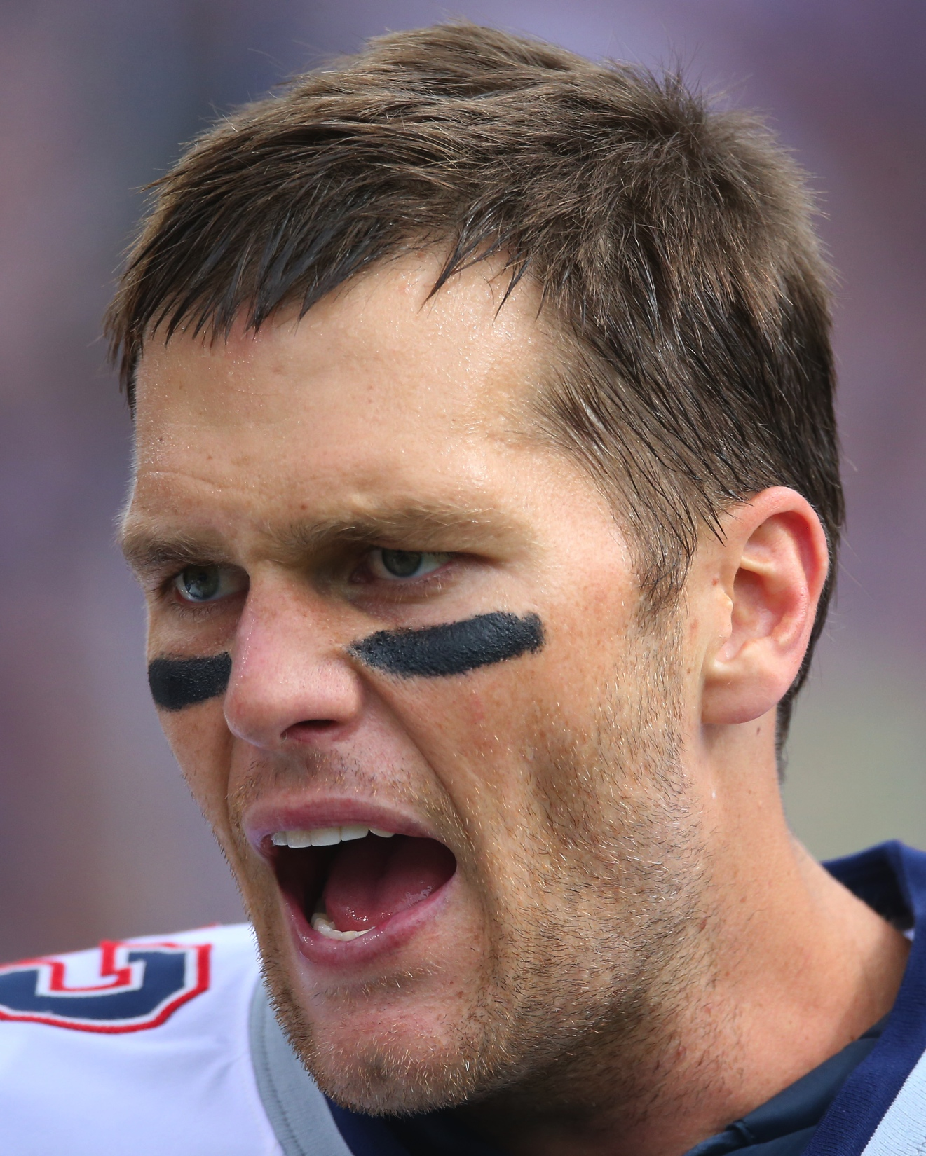
TOM BRADY FAILED WELL
Took Responsibility for Failure: Blamed No One
Learned Valuable Lessons From Failure
Kept a Positive Attitude on Failure and his Ability
Worked Really Hard to Overcome His Shortcomings

Slide 5
The Girl Who Never Made Mistakes
In order to discover the secret failing well, we are going to listen to a story quite the opposite of Tom Brady…

