Slide 1
Senior Nation Ames Health Program 2015 HOPE The Conversation in our Head & THE POWER OF OTHERS http://amesmindset.weebly.com

Slide 2
Man is the only animal that can imagine his own future. The belief that we can positively shape that future is called hope.
Relative Simplified Academic Competitiveness of Both Schools:
Harvard | Hartwick
Top 1/3 Class Average Math SAT=753
Middle 1/3 Class Average Math SAT=674 | Middle 1/3 Class Average Math SAT=472
Bottom 1/3 Class Average Math SAT=581 | Bottom 1/3 Class Average Math SAT=407

Slide 3
Hope is a way of thinking and is often shaped by the the Conversation in our Head
Negative Self Talk
Positive Self Talk
Self Talk

Slide 4
Our way of thinking is deeply shaped by Hope Creators
Negative Self Talk
The Power of Others: Hope Creators

Slide 5
As easily our hope is created, it can crushed by Hope Crushers
The Power of Others: Hope Crushers

Slide 6
You have a 700 on the Math SAT Due to your special talent, you are accepted to Harvard and Hartwick YOU WANT TO BE A DOCTOR WHICH SCHOOL SHOULD YOU CHOOSE? DISCUSS WITH A PARTNER: CHOOSE
Harvard | Hartwick
Top 1/3 Class Average Math SAT=753 | Top 1/3 Class Average Math SAT=569
Middle 1/3 Class Average Math SAT=674 | Middle 1/3 Class Average Math SAT=472
Bottom 1/3 Class Average Math SAT=581 | Bottom 1/3 Class Average Math SAT=407
Relative Simplified Academic Competitiveness of Both Schools:

Slide 7
CONGRATULATIONS You are now enrolled at Hartwick…

Slide 8
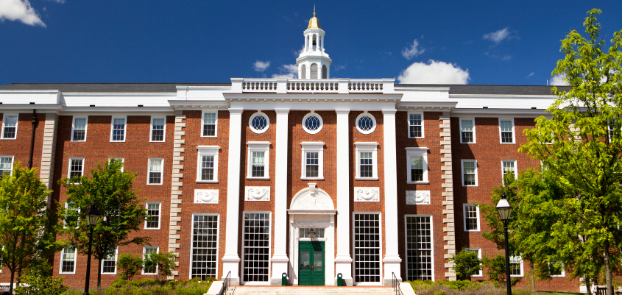
CONGRATULATIONS You are now enrolled at Harvard…

Slide 9
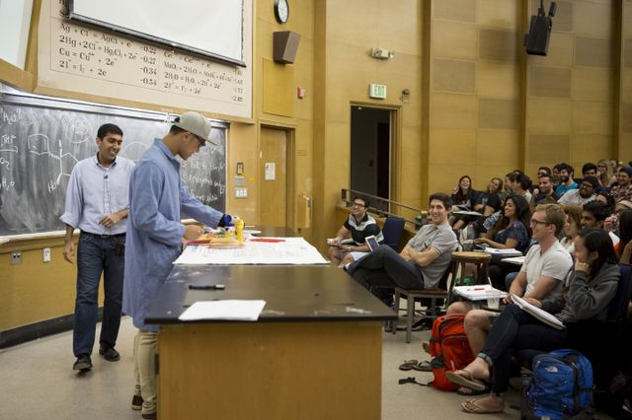
Junior Year of College: Time for your Test in Organic Chemistry… This is the make or break course for Medical School.

Slide 10
LET’S GO GO BACK TO HARVARD: FIRST TEST— ORGANIC CHEMISTRY MIDTERM GRADE B- This is NOT the best grade for Medical School. WHAT HAPPENS NOW?…Let’s see

Slide 11
WHAT HAPPENS TO THE CONVERSATION IN YOUR HEAD. This is NOT the best grade for Medical School. Which belief likely dominates the conversation in your head?…

Slide 12
HARTWICK: FIRST TEST— ORGANIC CHEMISTRY MIDTERM GRADE A+ This is a strong grade for Medical School. What is your conversation Like?

Slide 13
CAN YOU EXPLAIN THESE STATISTICS?….
Relative Simplified Academic Competitiveness of Both Schools:
Child Seeks STEM Degree
Harvard | Hartwick
Top 1/3 Class Average Math SAT=753 | Top 1/3 Class Average Math SAT=569
Middle 1/3 Class Average Math SAT=674 | Middle 1/3 Class Average Math SAT=472
Bottom 1/3 Class Average Math SAT=581 | Bottom 1/3 Class Average Math SAT=407
Percentage of that Graduate with a STEM Degree
Big Fish Little Pond/ Relative Deprivation
Harvard | Hartwick
Top 1/3 Class = 53.4% | Top 1/3 Class = 55%
Middle 1/3 Class = 31.2% | Middle 1/3 Class =27.1%
Bottom 1/3 Class = 15.4% | Bottom 1/3 Class SAT= 17.8%

Slide 14
What might happen in a nutshell
Even though you were at Harvard, one of the best schools in the world, and one of the smartest students in the country, the LOWER GRADE made you doubt you ability and lose your self belief. You only need to work harder, but might begin to doubt your ability to do it.
At Hartwick, even though you were not the top student in your high school, the HIGH GRADE AND SUCCESS increased your self belief and made you believe that you could do anything. You probably worked harder as a result of the grade and this success.
DOES THIS RESULTS TO THE GRADES AND RESULTS IN AP CLASSES AT MASSAPEQUA HIGH SCHOOL?
WHAT ABOUT THE POWER OF OTHERS TO CHANGE THESE CONVERSATIONS IN OUR HEADS?

Slide 15
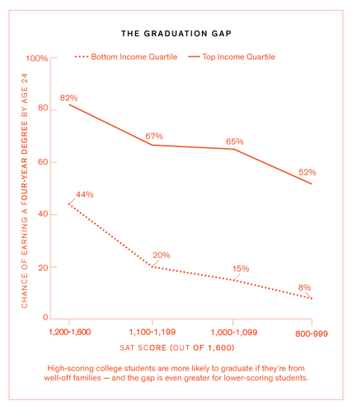
COLLEGE COMPLETION COMPARED WITH SAT SCORES FOR THE RICHEST TOP 1/3 AND POOREST TOP 1/3 The Reason Behind the Graduation Gap: THE POWER OF OTHERS

Slide 16
HOPE
Hope is not all about school!
Hope is dispositional in regard to
every aspect of lives, even our health.
HEALTH ISSUES (CANCER PATIENTS)
WORK LIFE
SOCIAL LIFE
MENTAL TRAUMA (DEPRESSION)
AGING

Slide 17
Hope is the measure of our will to achieve a goal (agency) added to our knowledge of what we have to do to achieve that goal (the ways to the goal, pathways).
Hope is not something we made up….It is a deeply researched concept
C. R Snyder: Rainbows in the Mind (2002)

Slide 18
Why Hope Matters to YOU now…
HOPE is a better predictor of college completion
than SAT, ACT, HS GPA
Four times more likely to not finish
college with low hope than low ability
Research of Dr. Rose and Dr. Seirup confirms this statistic locally demonstrating that low hope students on probation are at greatest risk of dropping out.
Shane Lopez Gallop Poll 2012

Slide 19
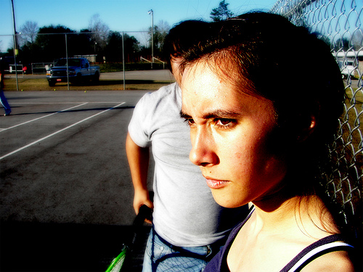
THINK ABOUT THE PERSON WHO CHANGED THE CONVERSATION IN YOUR HEAD FOR THE GOOD….CREATING YOUR HOPE
IT CAN BE THE TEACHER, PARENT, COACH OR FRIEND
WHO TOLD YOU---YOU CAN….OR YOU WILL

Slide 20
WHO CHANGED THE CONVERSATION IN YOUR HEAD?
TAKE A MINUTE AND REFLECT:
SHARE THIS WITH A PARTNER
WHAT NEXT?

Slide 21
LET’S FIND OUT HOW EASILY HOPE
CAN RISE OR FALL IN ALL OF US…

Slide 22
EXTRA CREDIT IN LIFE Seligman’s Gratitude Letter
GRATITUDE IS THE GATEWAY TO HAPPINESS
HOMEWORK:
Properly Thanking the Person Who Created Your Hope:
Write It
Send it
Deliver and Read It

