Slide 1
LESSON FOUR
WE NEED TO TEACH
“THAT GRIT IS THE MEASURE OF HOW BADLY WE WANT A GOAL AND IT GIVES RISE TO OUR PERSEVERENCE ”

Slide 2
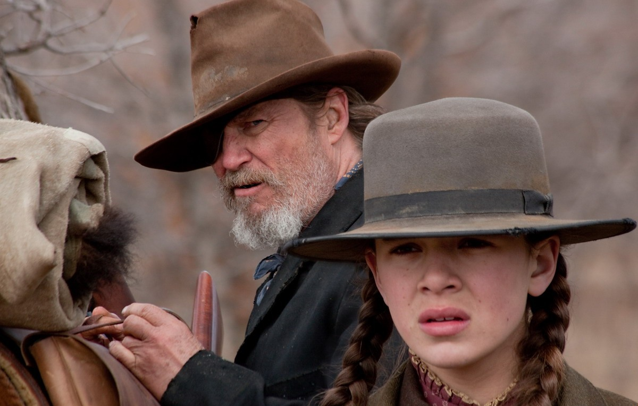
GRIT IS WHAT HAPPENS WHEN OUR HOPE IS TRULY TESTED Grit means that you maintain hope over time, no matter what the obstacle.

Slide 3
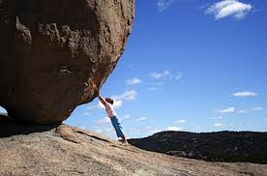
Sometimes, when we face obstacles, our hope is tested, our self-belief (hope) is truly tested!

Slide 4
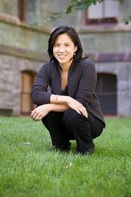
Dr. Angela Duckworth
Grit
Passion for a goal
Perseverance

Slide 5
Hope Feedback and Feedforward Model
Grit
Passion for the
Goal
Perseverance
for the Goal
Notes:
It might be interesting to make a new feedback model that includes grit to follow this. Maybe even happiness and life satisfaction?

Slide 6
What is deliberate practice?
• Setting a specific stretch goal • Concentrating 100% • Get immediate and informative feedback
• Practicing repetitively until fluency
Deliberate Practice is hard and not that much fun!

Slide 7
Identify and Share a Goal You Really Want to Achieve
(Seniors?)
HERE IS WHAT NO ONE TELLS
YOU ABOUT DELIBERATE PRACTICE
PRESEVERANCE, AND RESILIENCE
Those words are really easy to say, but the process can be painful. It can test your will and it is not something that can be explained. It must be experienced. If you really want to achieve a goal, it may be extremely painful.

Slide 8
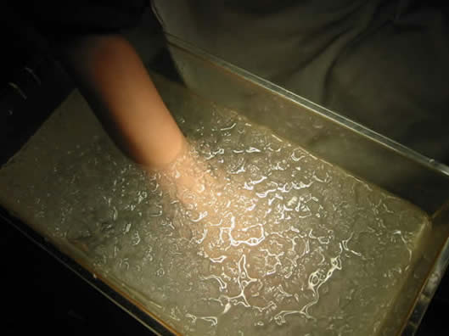
THE COLD PRESSOR TEST HOW BAD DO YOU WANT YOUR GOAL?
MAYBE IF YOU PULL YOUR HAND OUT,
YOU DID NOT REALLY WANT THE GOAL
THAT’S OK, NO KIDDING

Slide 9
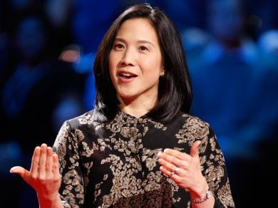
Dr. Angela Duckworth
Grit: A Measurable Construct
Duckworth Failed Well:
(She Thought success was a matter of Self-Regulation was the answer, but found no effect)
Passion for Long Term Goals
Perseverance to Achieve Long Term Goals

Slide 10
Dr. Angela Duckworth
Her Research
West Point Cadets
Spelling Bee Winners
Recognized Geniuses
I don’t know but isn’t it worth a try?
But Can We Teach Grit or Teach Kids To Be Grittier?

