Slide 1

CHANGING THE CONVERSATIONS IN THEIR HEADS
THE WAY AND THE WILL: AMERICAN GRIT
Dr. Kevin Sheehan
Kheehan1@molloy.edu
Molloy College
Division of Education
BERNER MIDDLE SCHOOL
December 18, 2014

Slide 2


Goals for Today
NO INJURIES—NO TUG OF WAR
REFLECT ON THE BIG PICTURE: WHAT IS THIS THING
CALLED TEACHING?
STRATEGIES THAT YOU CAN EMPLOY TOMOROW
FOLLOW UP: AVOID BEING THE FLAVOR OF THE
MONTH

Slide 3
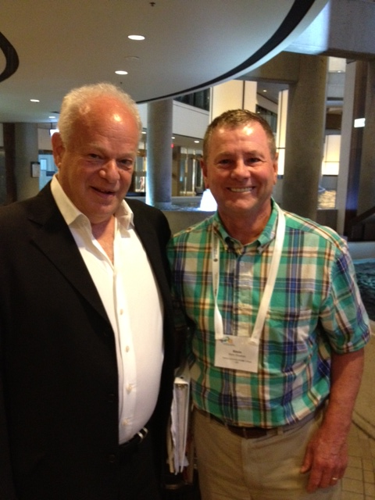
Positive Psychology
Dr. Martin Seligman
University of Pennsylvania
Most of the field of psychology brings to mind attempts to treat the 15% or so of the population who experience great difficulty in life. Positive psychology deals with the attempt to harness the research so that the other 85% of the population can live more fulfilling and happy lives.

Slide 4
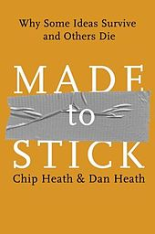
Power of Stories: Made to Stick
Heath and Heath
Stories activate
multiple areas
in our brain and
create greater
retention

Slide 5
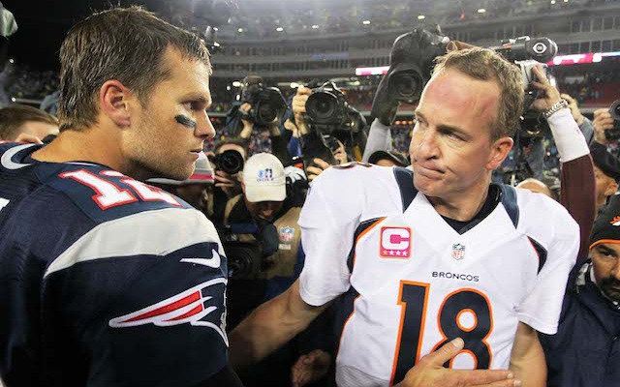
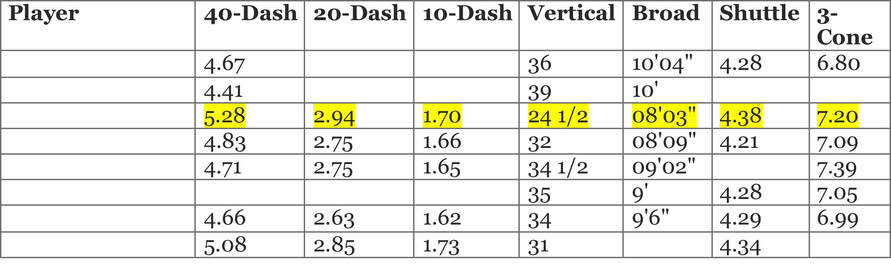
Pick an NFL Quarterback from the Combine Scores
Notes:
The defense is on the 9th right?

Slide 6

SELF-BELIEF
Trumps Ability
What we believe about
our ability becomes our reality…

Slide 7

There is a constant conversation in our
head, often subconscious, that measures
our belief on how we are doing and how we do in the face of new challenges….
This talk is ongoing and ties into our emotions.

Slide 8

College Statistics Punctuated by Negative Self-Talk:
Rick Snyder: University of Kansas
The conversation in our head begins with
Self Talk
In math, it sometimes starts looks like this….

Slide 9

This self talk can be positive or negative…. I can or I can’t…
IT IS THE WINDOW ON YOUR
SELF-BELIEF

Slide 10
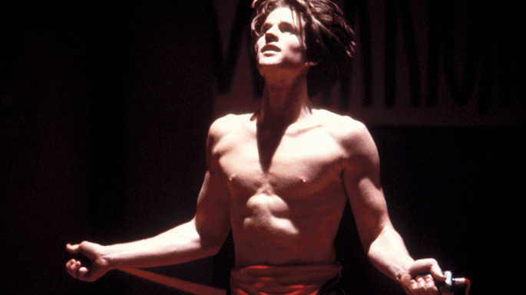
In the case of some, the conversation in the head takes the form of…
I WILL
THIS HAPPENS WHEN WE HAVE A TRUE PASSION FOR THE GOAL:
AGENTIC GOAL MOTIVATION…
WE MAKE MOVIES ABOUT THESE PEOPLE

Slide 11
ROLE OF A TEACHER
THE BASIC JOB OF A TEACHER IS TO IMPART INFORMATION:
STRONGLY DISAGREE AGREE STRONGLY
DISAGREE AGREE

Slide 12
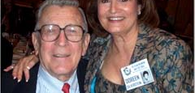
THINK ABOUT THE PERSON WHO CHANGED THE CONVERSATION IN YOUR HEAD….
IT CAN BE THE TEACHER WHO IMPARTED THE MOST
INFORMATION, BUT MOSTLY IT IS THE PERSON WHO
TOLD YOU---YOU CAN….

Slide 13
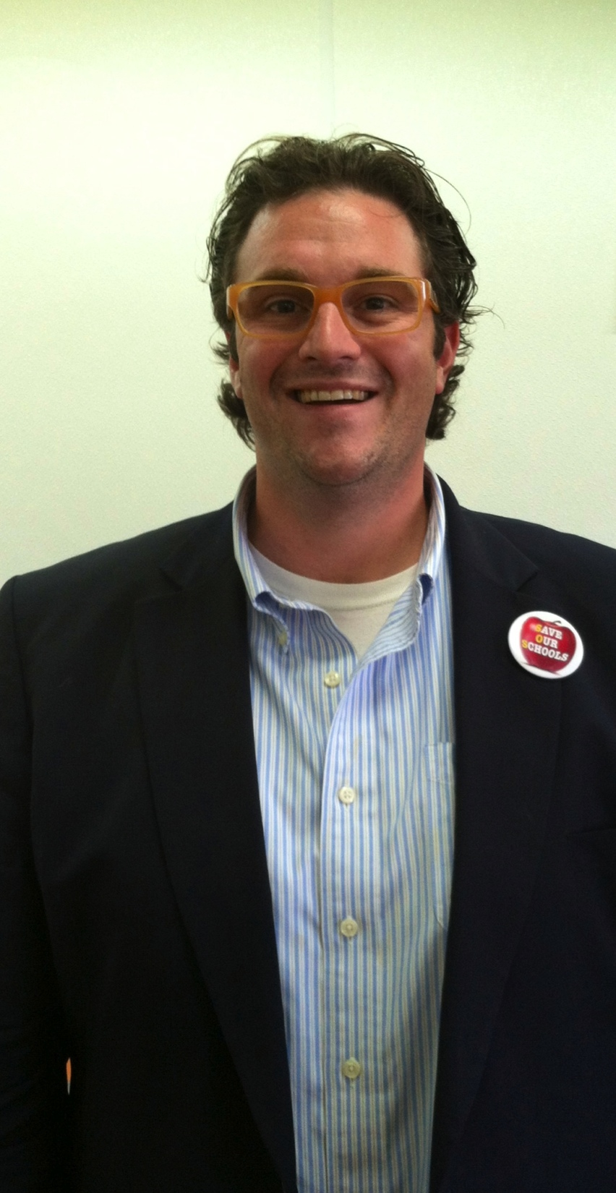
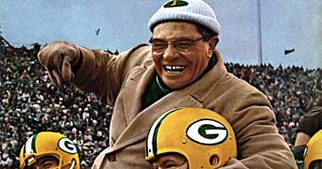
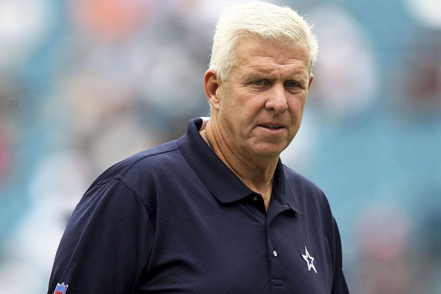
ROLE OF A TEACHER
A MAJOR PART OF THE JOB OF A TEACHER IS TO CREATE SELF-BELIEF:
STRONGLY DISAGREE AGREE STRONGLY
DISAGREE AGREE
THE BELIEF TO WIN
WHY AM I HERE?

Slide 14
I see conversations in the head everywhere….
David and Goliath: Underdogs, Misfits, and the Art of Battling Giants
Malcolm Gladwell
Relative Simplified Academic Competitiveness of Both Schools:
Child Seeks Admission to Medical or Engineering School
Harvard | Hartwick
Top 1/3 Class SAT=750-800 | Top 1/3 Class SAT=650-700
Middle 1/3 Class SAT=700-750 | Middle 1/3 Class SAT=600-650
Bottom 1/3 Class SAT-650-700 | Bottom 1/3 Class SAT=<600
Admission Statistics to Medical or Engineering School
Harvard | Hartwick
Top 1/3 Class SAT=750-800 56% | Top 1/3 Class SAT=650-700 56%
Middle 1/3 Class SAT=700-750 18% | Middle 1/3 Class SAT=600-650 18%
Bottom 1/3 Class SAT-650-700 4% | Bottom 1/3 Class SAT=<600 4%

Slide 15
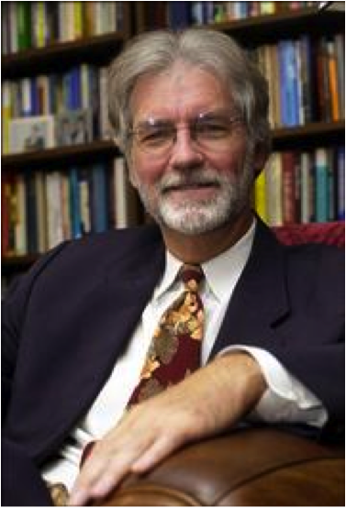
THE OTHER SIDE OF EXCUSES: C. R. SNYDER
THE WAY AND THE WILL
is the measure of our will to achieve a goal, our agency, added to our knowledge of what we have to do to achieve that goal, pathways, the ways to achieve a goal
Hope

Slide 16
Hope is the measure of our will to achieve a goal, our agency, added to our knowledge of what we have to do to achieve that goal, pathways, the ways to achieve a goal
C. R Snyder: Rainbows in the Mind (2002)

Slide 17
Self-report Psychological Tests
What is an instrument?
Hope Scales
Trait Hope Scale
  DHS (Dispositional or Trait Hope Scale) is a two-factor representation conceptualized as being composed of Agency and Pathways component. (PsycINFO Database Record (c) 2010 APA, all rights reserved)
Children’s Hope Scale
  DHS for children age 8-19
State Hope Scale
  This scale is responsive to events in the lives of people as evidenced by data gathered through both correlational and causal designs. It offers a brief, internally consistent, and valid self-report measure of ongoing goal-directed thinking. (PsycINFO Database Record (c) 2010 APA, all rights reserved)

Slide 18
Hope Theory:
Children’s Hope Test
1. I think I am doing pretty well.
2. I can think of many ways to get the things in life that are most important to me.
3. I am doing just as well as other kids my age.
4. When I have a problem, I can come up with lots of ways to solve it.
5. I think the things I have done in the past will help me in the future
6. Even when others want to quit, I know that I can find ways to solve the problem.
None of A little of Some of A lot of Most of All of
the time the time the time the time the time the time

Slide 19
Why the Will and the Way HOPE Matters…
Better predictor of college completion
than SAT, ACT, HS GPA
Four times more likely to not finish
college with low hope than low ability
Research of Dr. Rose and Dr. Seirup confirms this statistic locally demonstrating that low hope students on probation are at greatest risk of dropping out.
Shane Lopez Gallop Poll 2012

Slide 20
Altering a student’s hope level WILL
improve a student’s academic performance.
HOPE
LEVEL
GPA
EMOTIONAL
&
BEHAVIORAL
ENGAGEMENT

Slide 21
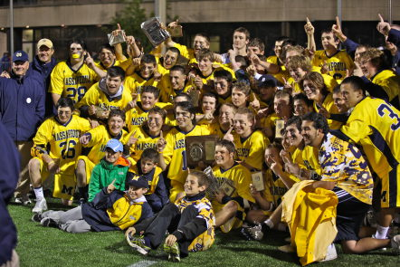
Hope in athletics…

Slide 22

The Quiet Crisis:
The Other Side of the Rainbow in the Mind
THE OTHER CONVERSATION
Alternative School Students
Over 1,000,000 students in America
64% Schools in America.

Slide 23

STORM CLOUDS IN THE MIND
Could it be the problem in our alternative school population is not a lack of ability on the part of the student, or the teacher, or the materials….
BUT THE FACT THAT THE STUDENT HAS LOST HOPE?

Slide 24
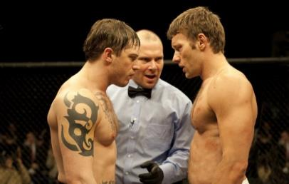
ORIGINS OF LOW HOPE
Deficits in the primary giver resulting in low attachment
Stages:
Rage-Despair-Apathy

Slide 25
Research Questions:
Research Question 1: Are hope and grit factorially distinct from one another?
Research Question 2: Are there significant correlations among hope, grit, happiness, life satisfaction and academic achievement?
Research Question 3: Are there statistically significant differences between alternative school students and traditional school students in hope, grit, happiness, life satisfaction, and academic achievement?
Research Question 4: Do hope and grit scores predict academic achievement beyond happiness and life satisfaction?

Slide 26
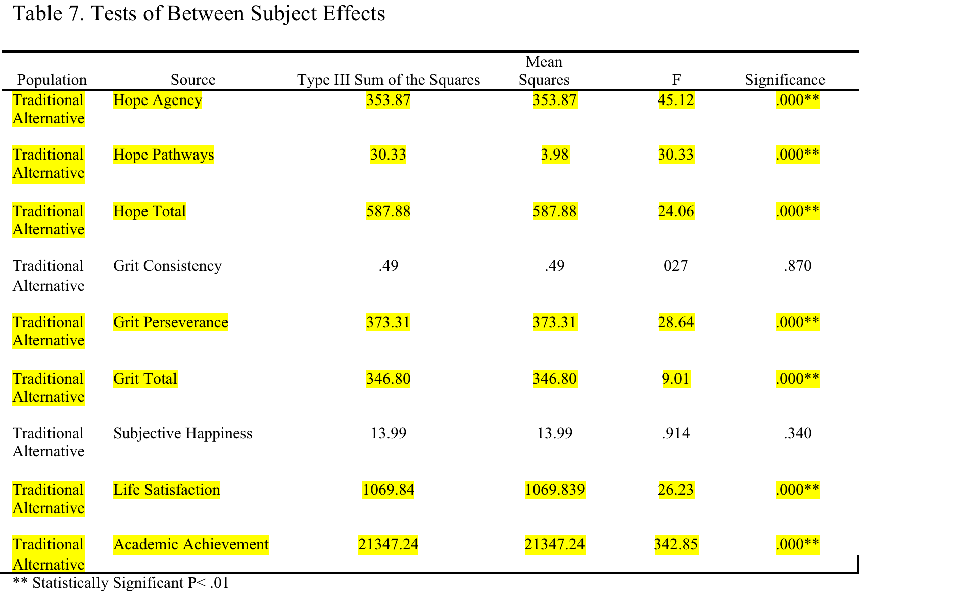
Results for Research Question 3: Are there statistically significant differences between alternative school students and traditional school students in hope, grit, behavioral engagement, happiness, life satisfaction and grade point average?
Notes:
I wonder if reverse highlighting would be more impactful. Just highlight the non-significant to point out what was NOT different.

Slide 27
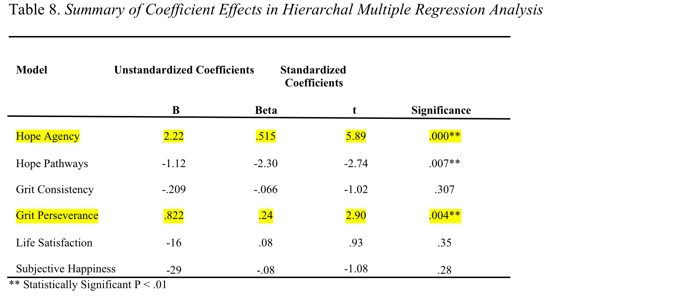
Results for Research Question 4: Do hope and grit scores predict grade point average beyond engagement, happiness, and life satisfaction in student populations?
Notes:
Don’t forget to mention how pathways didn’t really work in the direction it was suppose to and this may be b/c agency is taking all of the variance in predicting GPA. But overall the agentic goal setting constructs are what predict GPA.

Slide 28

The best news about hope is that it is a way of thinking and not an emotion that we are born with. If can we change our way of thinking, we can change our hope.

Slide 29
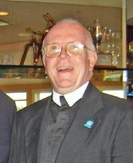
SHATTERING THE ODDS:
Can a School Actually Create Hope?
Does Hope float?
Brother Thomas Casey’s Mission
The De La Salle School, Freeport, NY

Slide 30
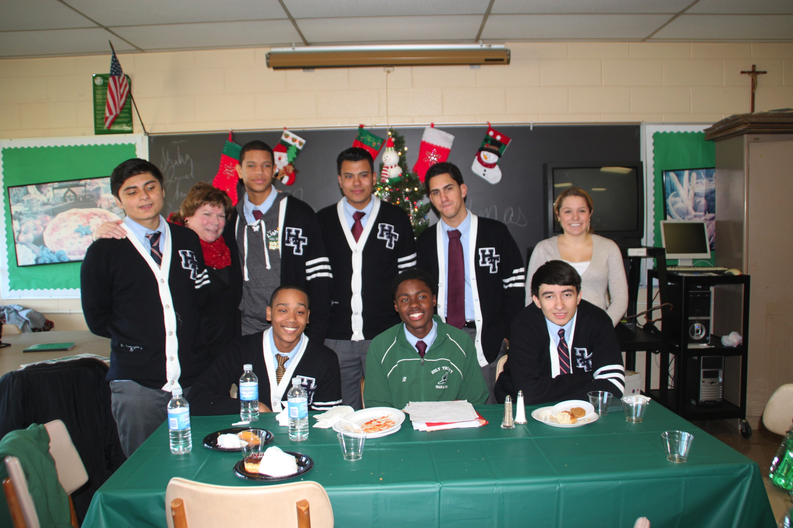
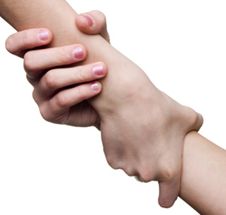
HOW DO WE CREATE HOPE?
HARNESSING THE POWER OF GOALS: Creating will
THE DE LA SALLE SCHOOL.
Mastery Experiences: Successful Experiences
Persuaders: HOPE CREATORS
Community: Vicarious Others/Celebration of your goals

Slide 31
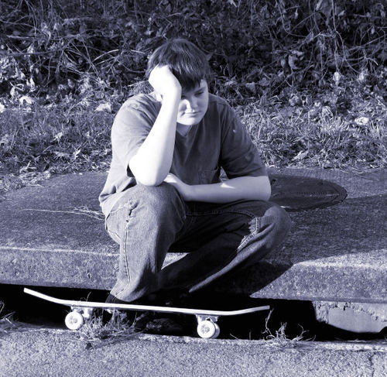
HOPE CRUSHERS:
Destroying the
Will
.
FAILURE: Nothing destroys agency quite like failure
HOPE CRUSHERS: “You’ll never do it!”
VIVARIOUS OTHERS: Negative Friends
Community: Negative Effect on your goals

Slide 32
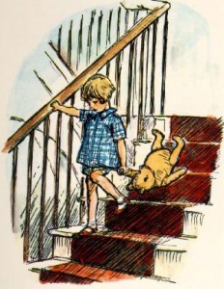

Here is Edward Bear…
Our Mission: CHANGING THE CONVERSATIONS IN THEIR HEADS
Is the mission of a school to impart information or change the conversation in our heads…

Slide 33
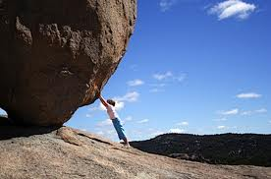
When we face obstacles, our hope is tested, our self-belief is truly tested!

Slide 34
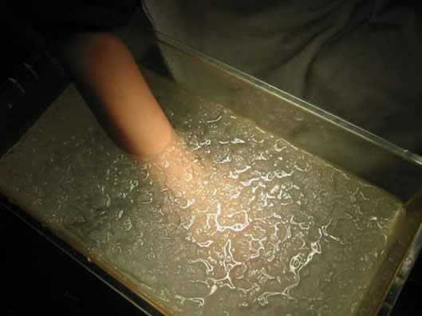
What happens when our hope is tested?
What is the cold presser test?

Slide 35

GRIT IS WHAT HAPPENS WHEN
OUR HOPE IS TRULY TESTED
Grit means that you will not quit, no matter what the obstacle on the path to your goal
. (Grit is hope in the face of adversity and consistency of effort).

Slide 36
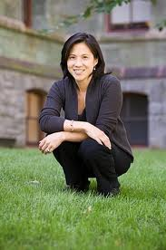
Dr. Angela Duckworth
What is that makes us successful in life…
Grit
Passion for the long term
goals (How bad do you
want it?)
Perseverance to attain
long term goals in the face
stressors

Slide 37
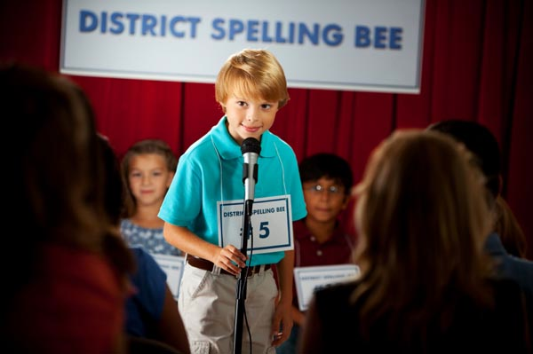
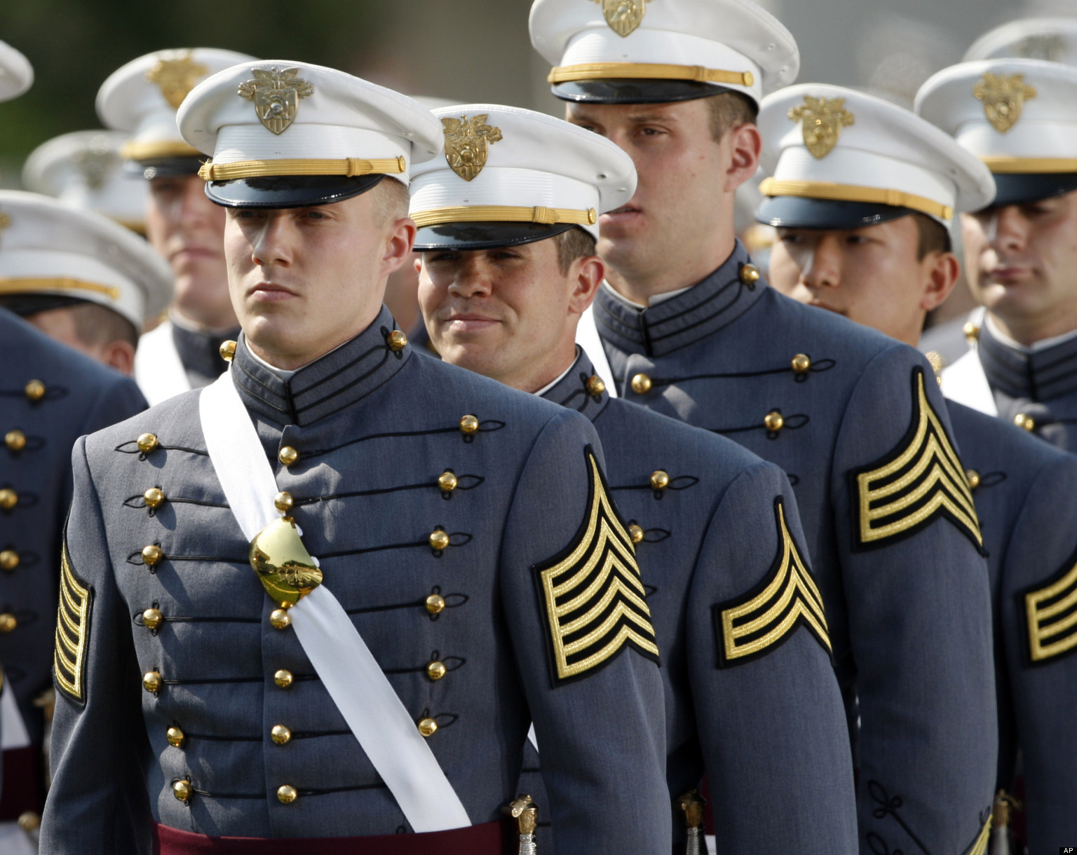
What do:
West Point Plebes
Spelling Bee Champions
Recognized Geniuses
have in common?

Slide 38
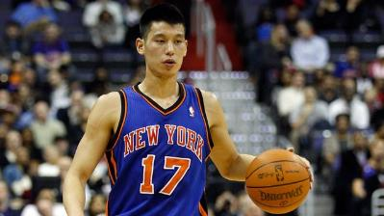
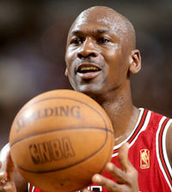
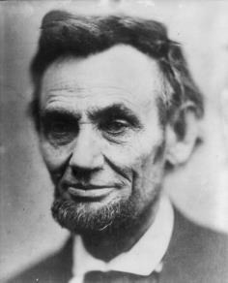
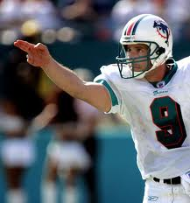
GRIT/SUCCESS
is how bad you want it!
(Your Goal!)

Slide 39
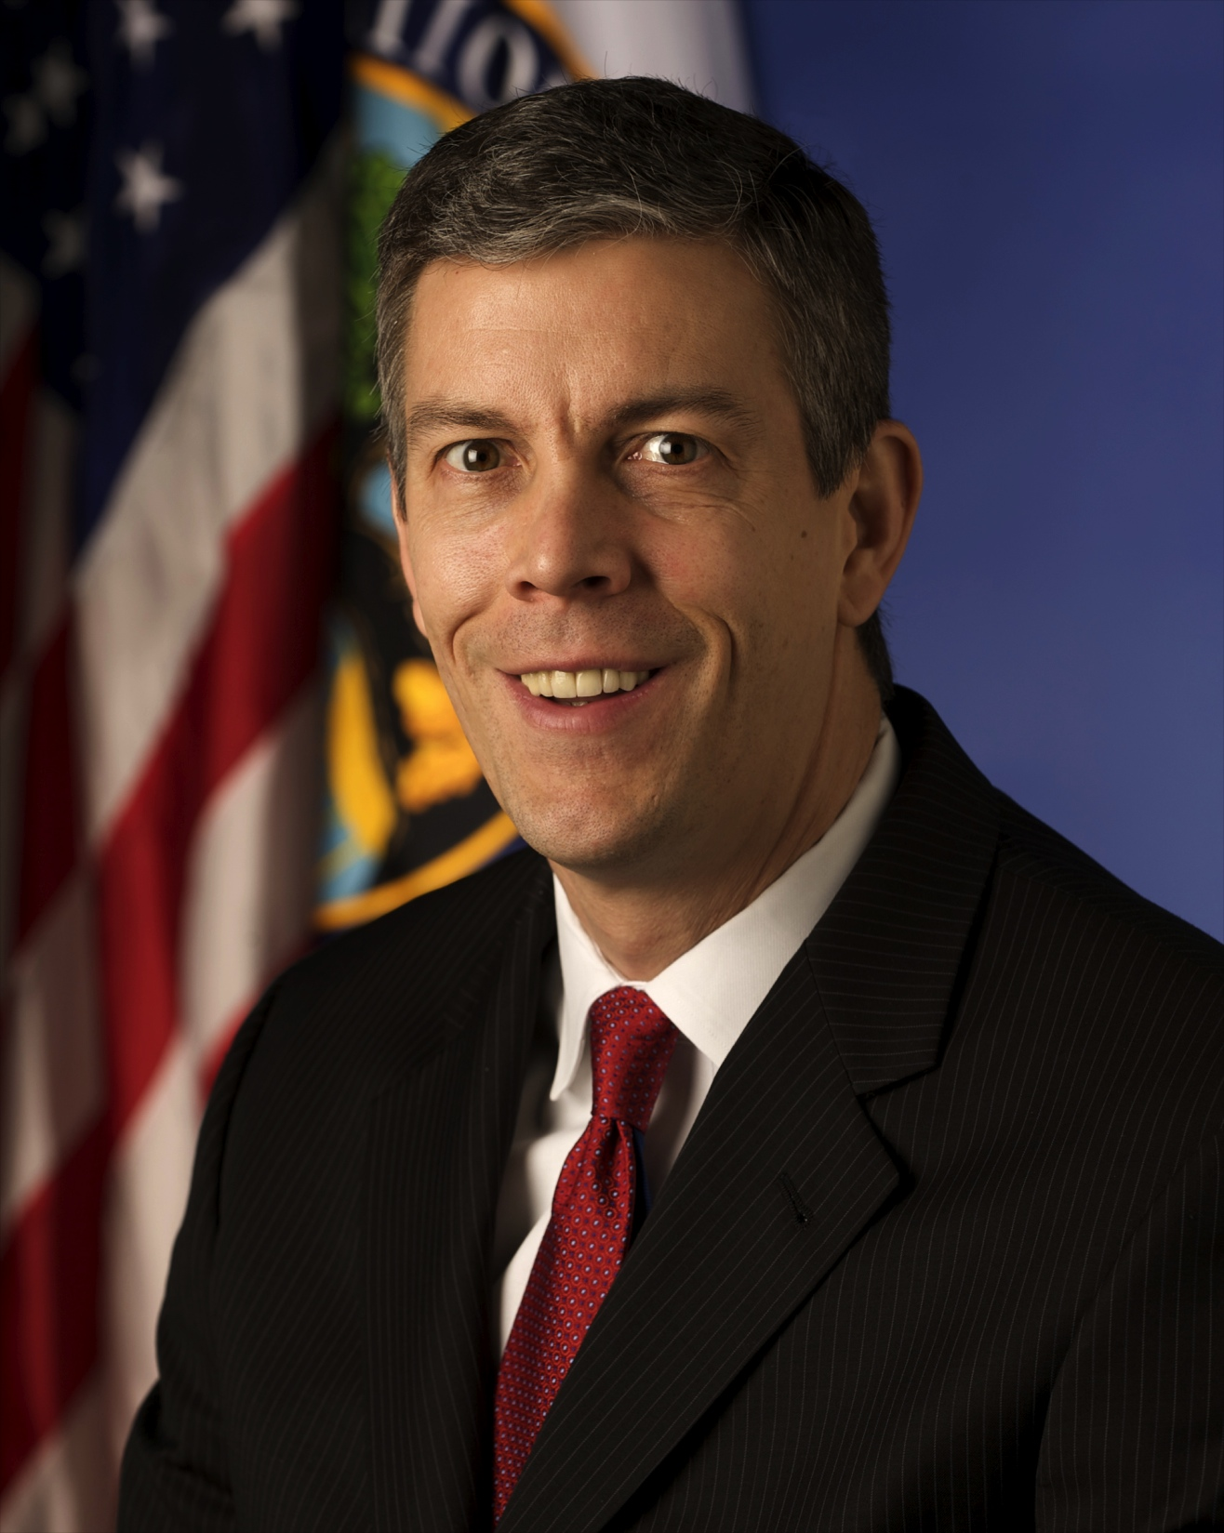
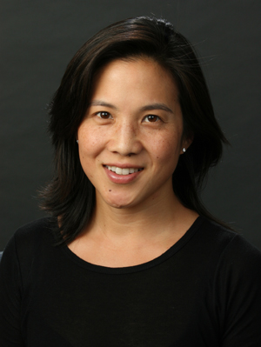
Duckworth is the poster child
of the Common Core Movement

Slide 40
Hope Feedback and Feedforward Model
Grit
Passion for the
Goal
Perseverance
for the Goal
Notes:
It might be interesting to make a new feedback model that includes grit to follow this. Maybe even happiness and life satisfaction?

Slide 41
What is deliberate practice?
• Setting a specific stretch goal
• Concentrating 100%
• Get immediate and informative feedback
• Practicing repetitively until fluency
Deliberate Practice is hard and not that much fun!

Slide 42
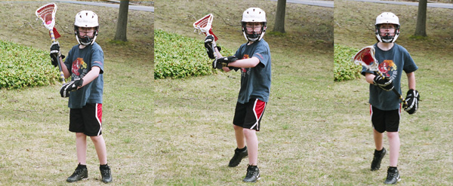
Deliberate Practice:
Practicing What You are Bad At!

Slide 43
Much of Duckworth's Thinking is related to the work of Anders Erikson on World Class Experts 10,000 Hour Rule
World Class Experts
Capacity is part of the process certainly, but 10,000 Hours of Deliberate Practice are required for expertise and world recognition. (Talent Code: Daniel Coyle)
Why isn’t everyone an expert? The secret of ignition (Inspiration, Belief and Example)
What is it?
Notes:
Accepting, acknowledging, tolerating

Slide 44
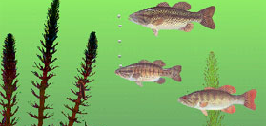
Geography of Thought: William Nesbitt
THE IDEA OF AMERICAN GRIT

Slide 45


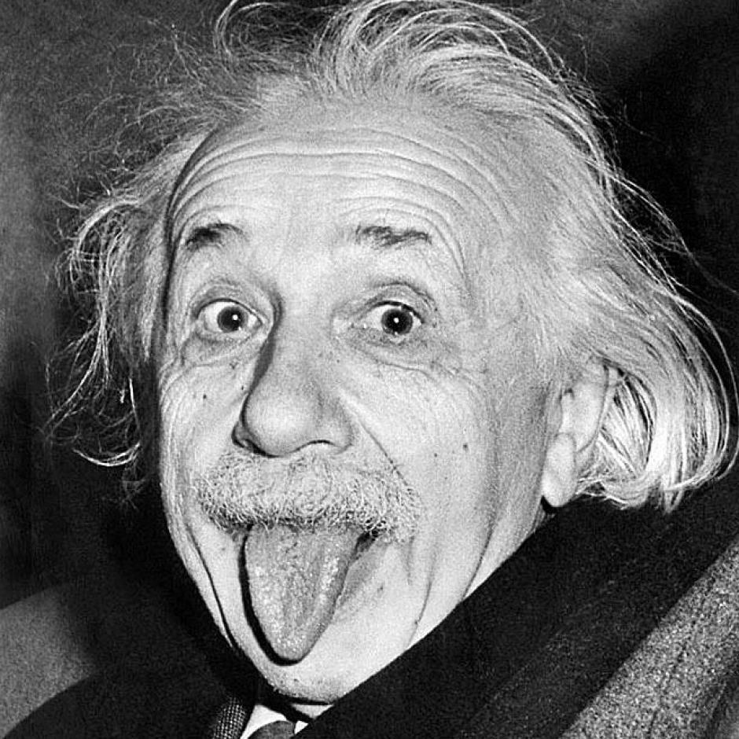
Nesbitt: Culture Casts a Long Shadow
For Americans in the
words of Albert Einstein…
Love is a better teacher than duty
American genius is
Not driven by duty…

Slide 46
What Common Core Gets Wrong…
The key factor in the American genius is the passion that we generate in our students for the goal. American will not climb the staircase of complexity because we are lagging behind the world.
WE WILL DO A GREAT DISSERVICE TO OUR STUDENTS IF WE FAIL TO RECOGIZE THAT THE SOURCE OF OUR GREATNESS IS THE CREATIVITY THAT UNLOCKS THE AMERICAN PASSION.

Slide 47
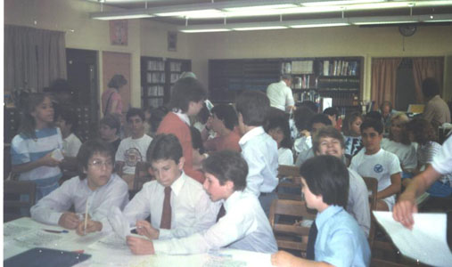
What Common Core, Arne Duncan and
Get Wrong…
IGNITION: LIGHTING THE SPARK
Educating the Imagination: flow.

Slide 48
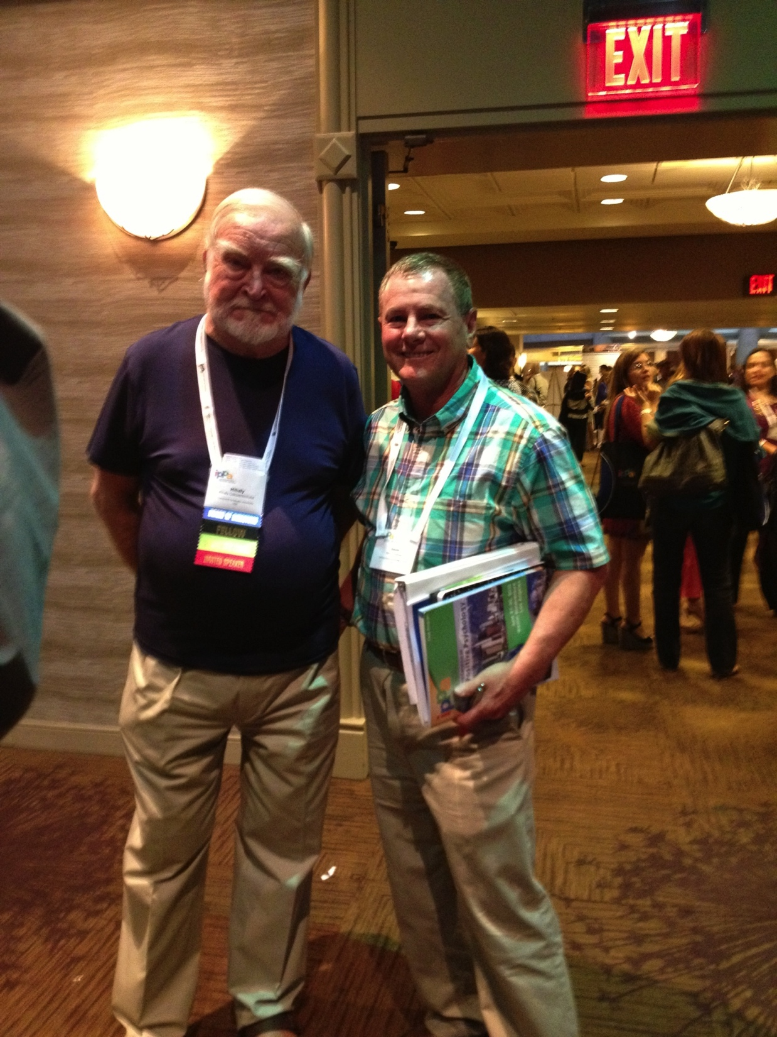
What is Flow?

Slide 49
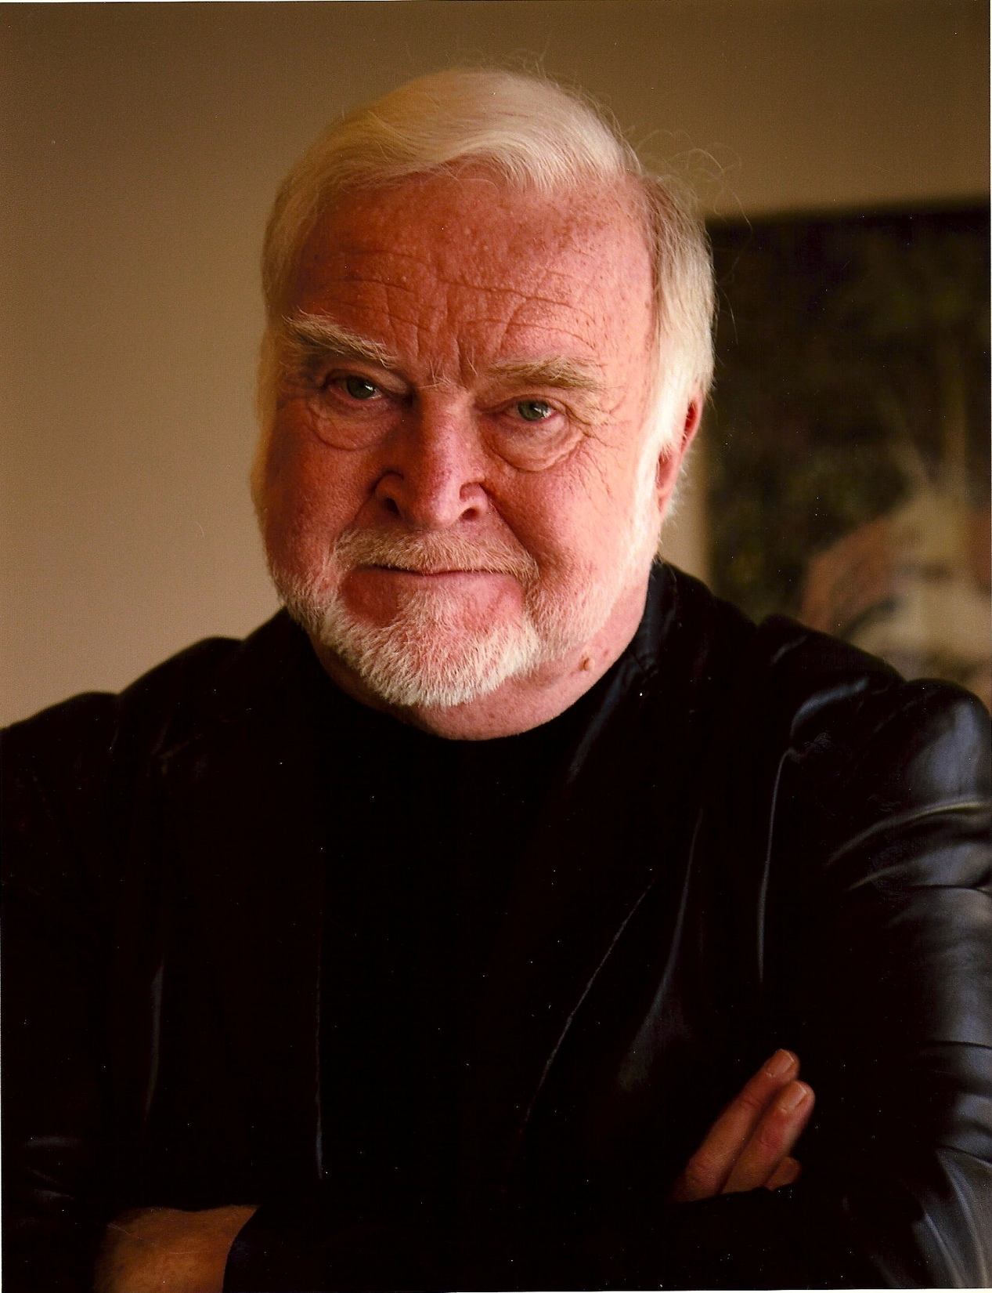
American Grit: Find Your Passion
For Americans, deliberate
practice is based on passion—
American genius is born of love.
American genius’s do not achieve
out of duty—but work more in flow—
—”mental state of operation in which a person performing an activity is fully immersed in a feeling of energized focus, full involvement, and enjoyment in the process of the activity. In essence, flow is characterized by complete absorption in what one does. Mihaly Csikszentmihalyi

Slide 50
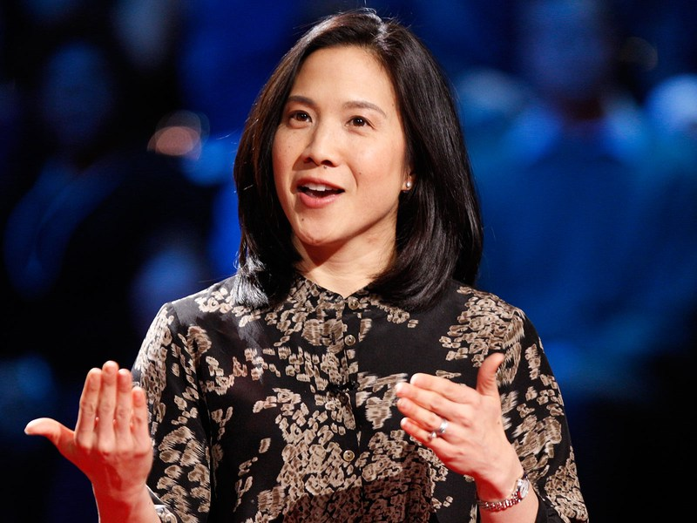
Duckworth’s Key Question Remains
Key Question Still Remains.
HOW DO WE GET KIDS TO BE MORE GRITTY?
GRIT IS SEXY
WHY AREN’T THEY MORE GRITTY?

Slide 51
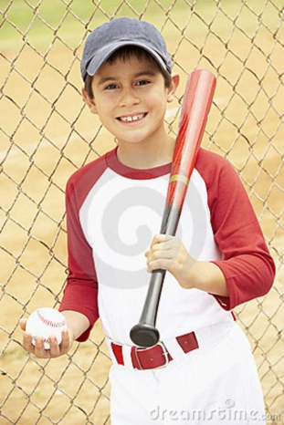
THE DANGERS OF EARLY SUCCESS
“You’re a Natural”
There are tragic consequences to labeling a child a natural
in school or sports.
What are the consequences of this early sentence of greatness? What beliefs does this praise result in and what are the consequences of these beliefs?

Slide 52
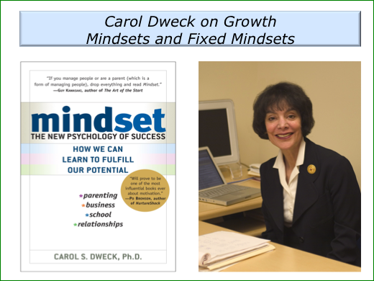
FIXED OR GROWTH MINDSET:
PERFORMANCE BASED ON
CAPACITY OR EFFORT
IS OUR PERFORMANCE BASED ON INNATE CAPACITY OR MALLEABLE BASED ON OUR EFFORT?
WHAT DO YOU BELIEVE?

Slide 53
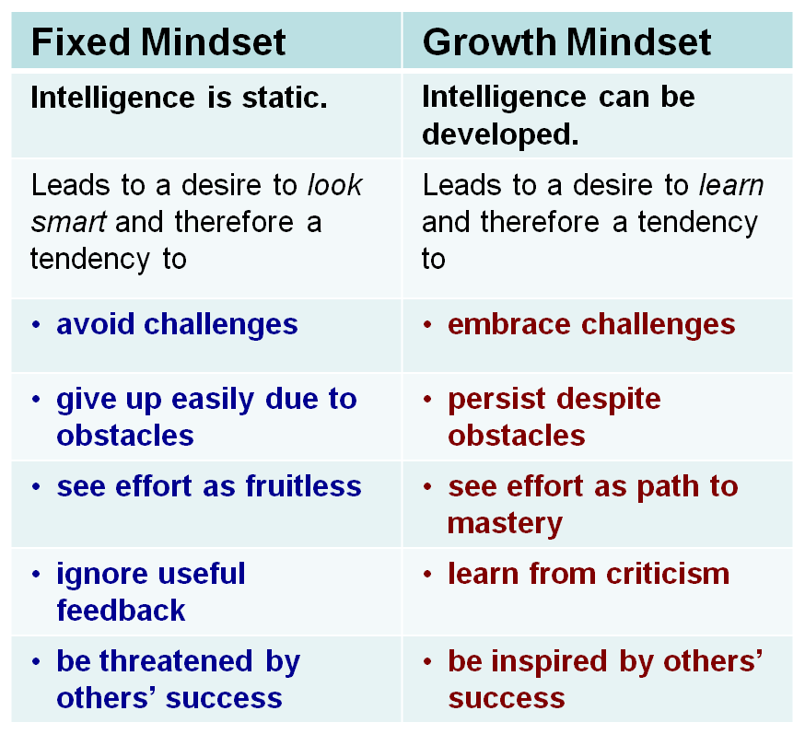
The Power of Effort

Slide 54
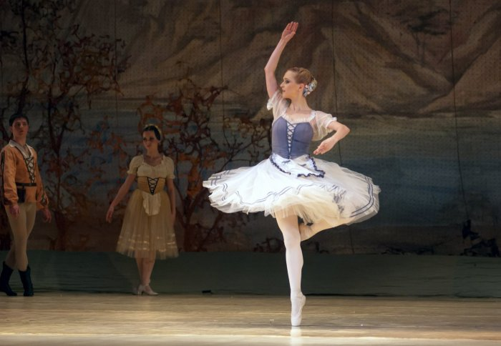
WHAT ROLE DO TEACHERS PLAY IN MINDSET?
The E School and I School of Turning?

Slide 55
STRESS THAT ARISES FROM PERFORMANCE GOALS…
PERFORMANCE VS. MASTERY GOALS
LEARN BY DOING: JOHN DEWEY—SEE IF YOU CAN DIFFERENTIATE A PERFORMANCE GOAL FROM A MASTERY GOAL
WE SEND MIXED MESSAGES—NUMBERS DON’T MATTER—YET THEY OFTEN ARE THE ONLY THING THAT MATTERS. (COLLEGE ACCEPTANCE, RECRUTING)
THIS PRESSURE PERMEATES IN MASSPEQUA, A CULTURE BUILT ON SUCCESS-LOSE IN COUNTIES YOU ARE A FAILURE—NOT ON HONOR ROLL--
DESTROYS CHILDREN:
PARENTS CAN BE WORST CULPRITS

Slide 56
WHAT DO WE BELIEVE ABOUT MINDSET?
I THINK THERE IS AN EXPECTED ANSWER
THAT WE GIVE TO THAT QUESTION AND
ANOTHER ANSWER DEEP IN OUR HEARTS
MY OCEANSIDE ROLE AS CHAIRPERSON AND THE AP
GATEKEEPER
TELL THE TRUTH ABOUT HARD WORK
AND EFFORT TO CHILDREN
(IT’S NOT A BIRTHDAY PARTY)

Slide 57

Who Gets to Graduate?
NY Times: Paul Tough 5/15/14
Vanessa’s Story

Slide 58
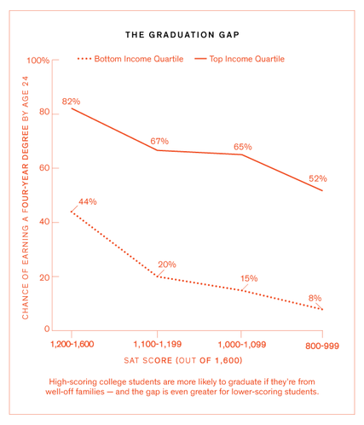
Vanessa’s Story May Be the Story for All Children of Poverty
The Graduation Gap

Slide 59
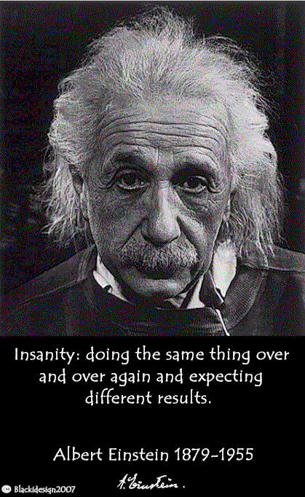
Changing the Conversations in Their
Heads Will Be a Continuing Process!
Talk About Effort not Performance
Tell the Truth About Hard Work and Goals
Celebrate Grit
Stress Mastery Goals and Build in Passion for the Subject
Mental Contrasting (Duckworth)
Where and When Goals
Create a culture of effort, hope and grit?
Create Resources for Parents and Students to Help Us Build this Culture

Slide 60
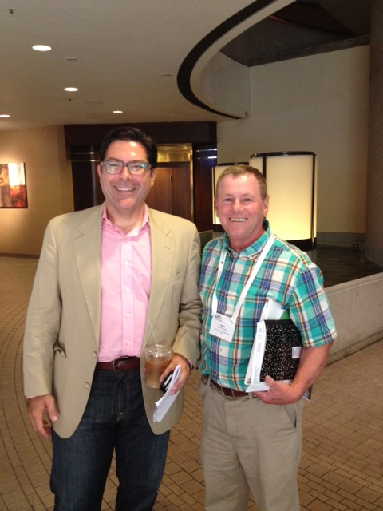
Making Hope Happen:
Shane Lopez
Where When Statements
Where will I do this?
When will I do this?

Slide 61
Dr. Angela Duckworth
Mental Contrasting
Optimism
Pessimism
If then statements

Slide 62

We need as a community at Massapequa to develop
a common language, purpose and
goal of celebrating effort……
We can even build this vocabulary
and analysis into our culture
Let’s go to the website
Our Stories

Slide 63
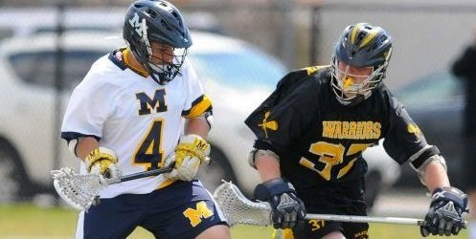
Massapequa’s New Site:
The Will and the Ways: Secret of American Grit
Background to Enable You to Continue the Conversations that We Began Today:
Video
Popular Articles
Research Article
Book
Produce our Own Stories
Of Massapequa Hope, Grit and Effort
Joe DeMarco:
Syracuse University

Slide 64
Flipped Instruction
1. Non-judgmental (Unlike you or me, who has taught this for over ten (?) years...I CAN BE CRANKY)
2. Allows the learner to work at their own pace and to their own natural ability. Do it over and over, if needed.
3. Allows parents to be a part of the process. Breaks the Omerta code.
4. Is proof that you explained it for the student who maintains that you did not.
5. Is forever—do it once and you can use it the next year.

Slide 65
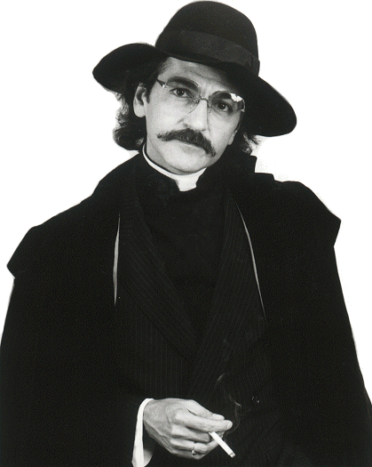
Guido Sarducci: The Five Minute University
Got Another Minute:
WANT TO BE HAPPY THIS HOLIDAY SEASON?

Slide 66
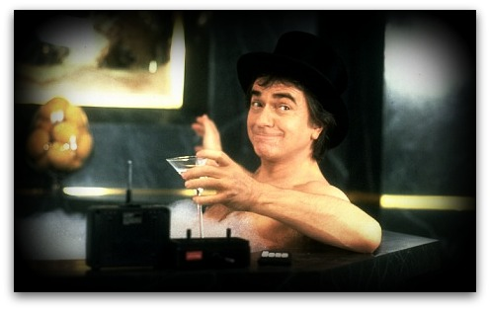
Is Dudley Moore Happy?
ORIGINAL MOVIE
Are we Happy??

Slide 67

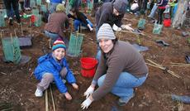
HAPPINESS:
Hedonic vs. Eudemonic
Well Being

Slide 68

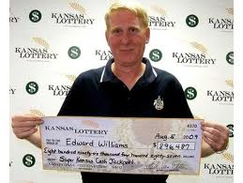
Who is happier?
Amputees or Lottery Winners?

Slide 69
Happiness Formula
50% Genetic
10 % Life Circumstances
40% How we
deal with Life
(Behave and Think)

Slide 70
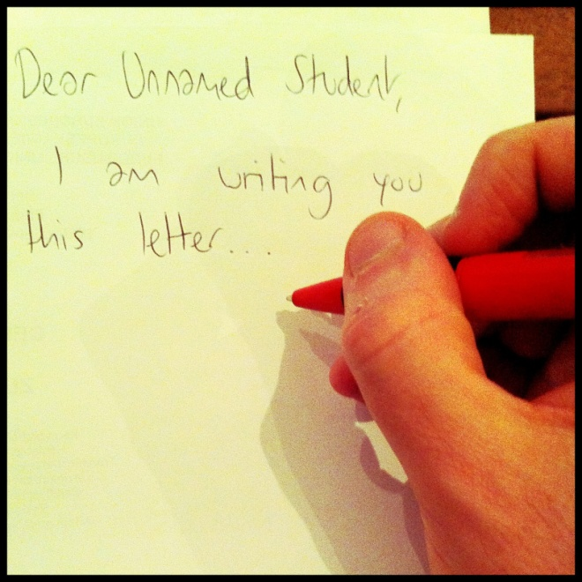
Seligman’s Gratitude Letter
Write It
Send it
Deliver and Read It

Slide 71

Why Gratitude?
Finding the time
for Savoring

Slide 72

Summer Course: Changing the Conversations
Week Before July 4th
^{Monday-Thursday 8am -3pm}
$900 3 Graduate Credits—INSERVICE ALSO
Thank you or your kind and gracious attention
Ksheehan1@molloy.edu

